Slide 1
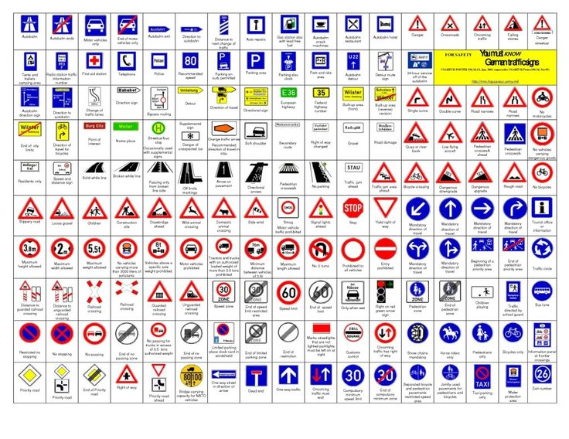
Capstone Project German Traffic Sign Recognition
Presented by Antonin STUBER

Slide 2
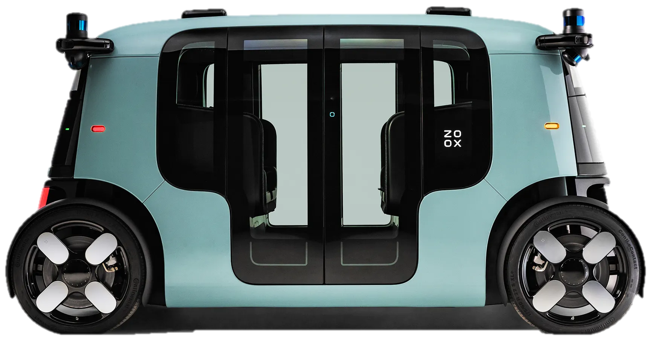
Agenda
Bio
Business problem
Values Delivery
Conclusions
Key figures
Overall process flow used
Summary
Exploration Data Analysis
Stakeholders
Preprocess
Conclusion
Data question
Modelling + Evaluation
Best model
Next steps
Dataset
Deployment

Slide 3

Bio
- Master in Supply Chain Management
- 2 years experience as Data scientist in gas sector
Antonin STUBER

Slide 4
Agenda
Bio
Business problem
Values Delivery
Conclusions
Key figures
Overall process flow used
Summary
Exploration Data Analysis
Stakeholders
Pre-process
Conclusion
Data question
Modelling + Evaluation
Best model
Next steps
Dataset
Deployment

Slide 5
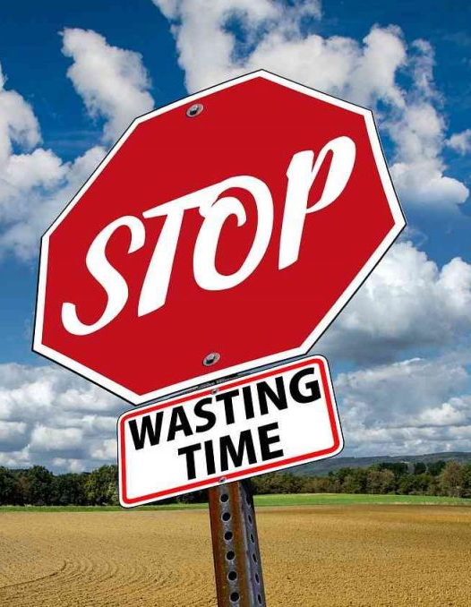

Overview
Key figures
48
52.7%
52.7% (6,347,498 people) of the Australian workforce drove to work by car only (2021)
Australians commuting on average 48 minutes per day
The Household, Income and Labor Dynamics in Australia (HILDA) Survey

Slide 6
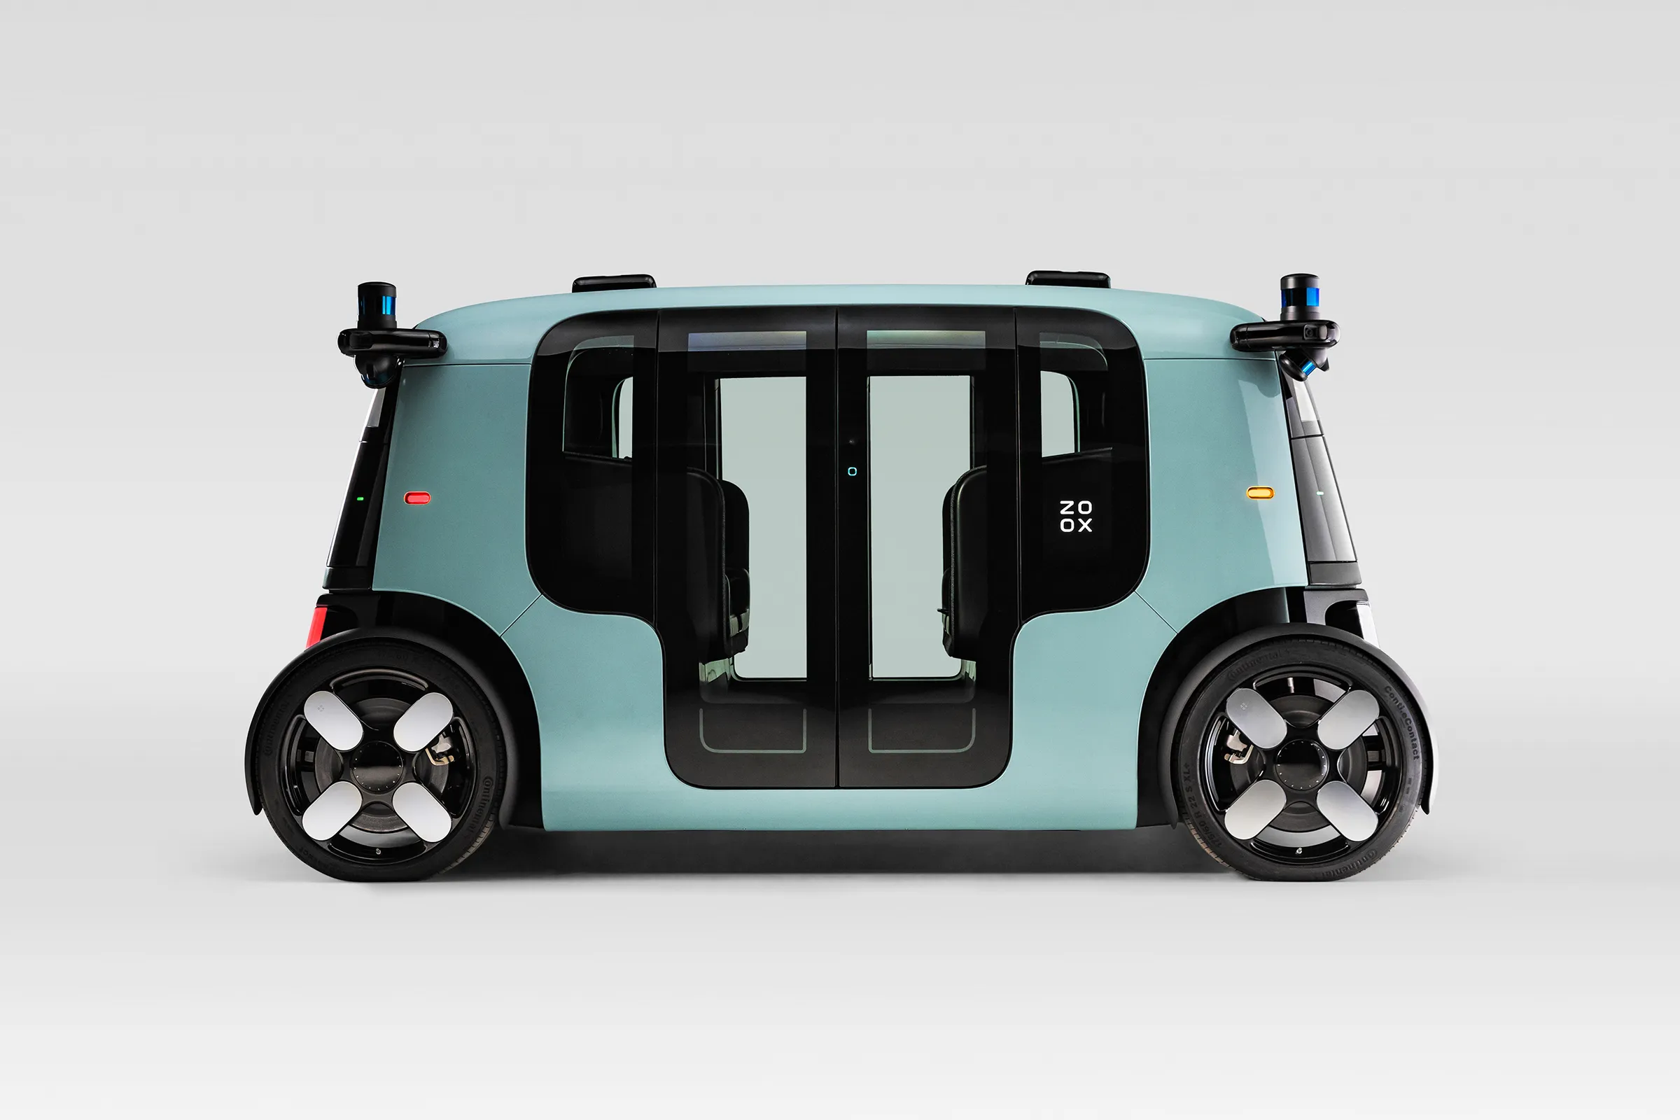
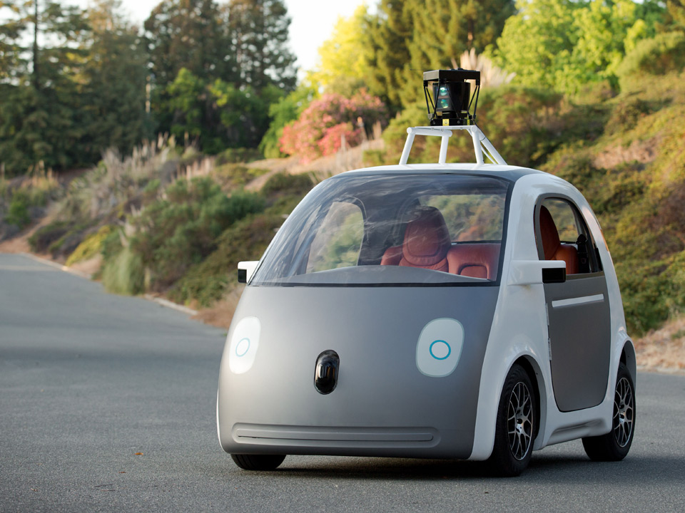
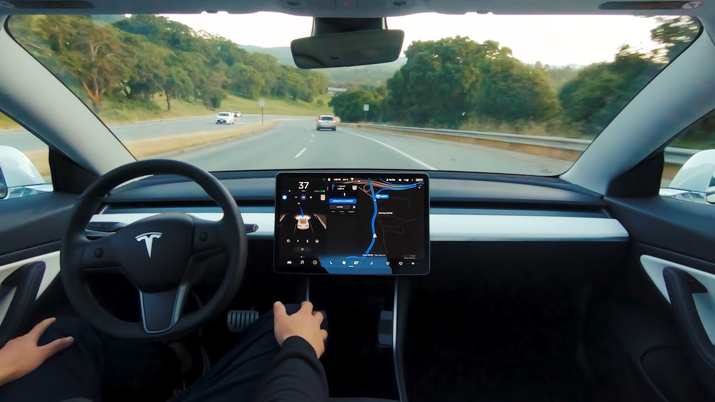
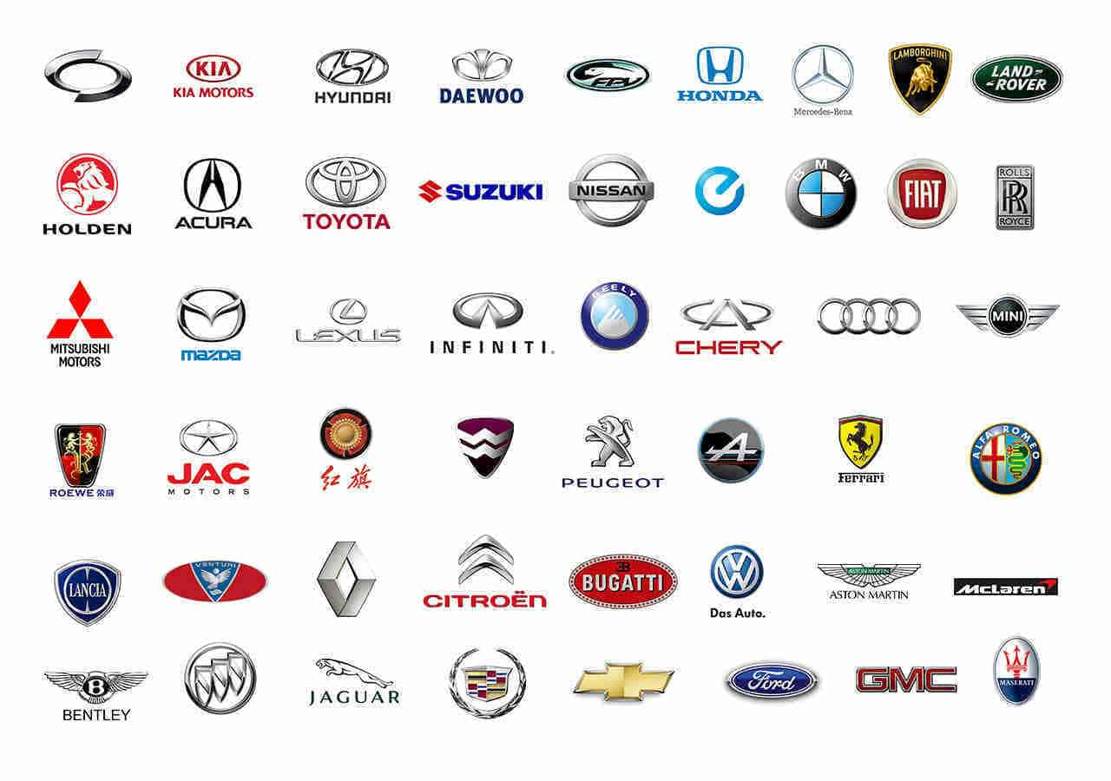
Overview
Stakeholders
Google
Tesla
Carmakers who think autonomous car is the future

Slide 7
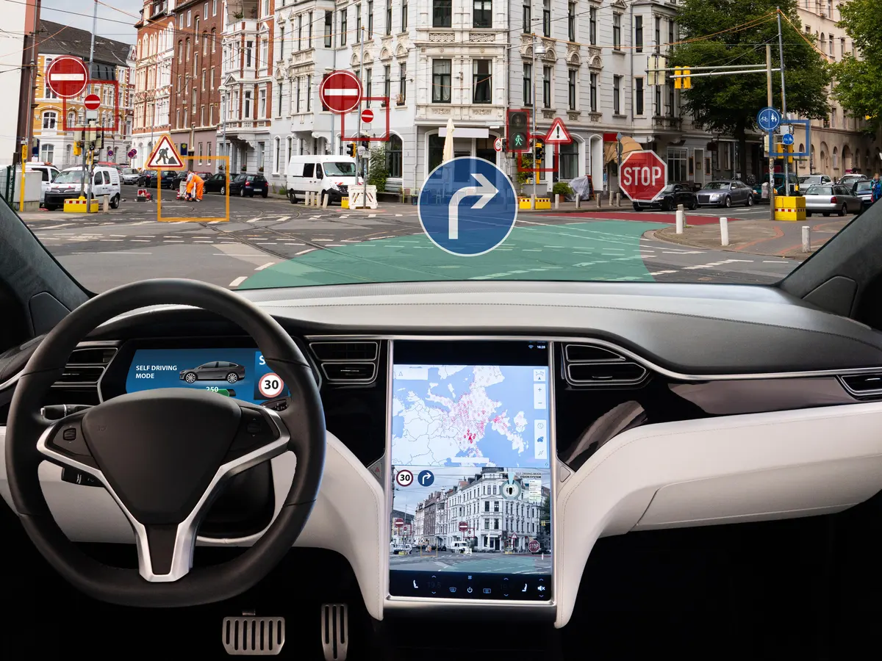
Overview
Data question
Business question :
How well a car can recognize a traffic sign ?
Data question :
What machine learning model could be used to recognize a traffic sign from a predefined list and the most accurate and fast as possible ?

Slide 8

Overview
Dataset
Dataset from Kaggle
50,000+ labelled images of German traffic sign
43 different types of sign
Images with different dimensions

Slide 9
Agenda
Bio
Business problem
Values Delivery
Conclusions
Key figures
Overall process flow used
Summary
Exploration Data Analysis
Stakeholders
Pre-process
Conclusion
Data question
Modelling + Evaluation
Best model
Next steps
Dataset
Deployment

Slide 10
Values Delivery
Overall process flow used
Business question
Business answer
Modelling
Evaluate the model
Data question
Data answer
Pre-process
EDA
DATA
SOLUTION
Deployment

Slide 11
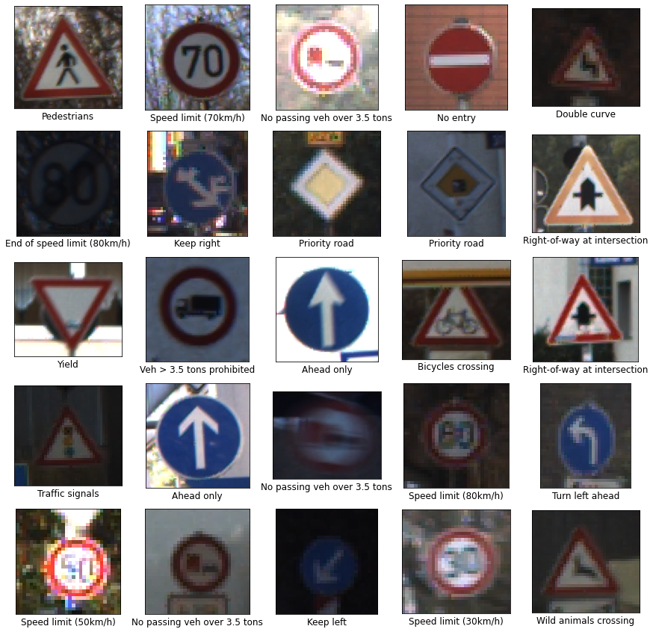
Values Delivery
Exploratory Data Analysis
Images
Stickers on the sign
Different luminosity
Partially hidden
Low resolution
Blurry

Slide 12
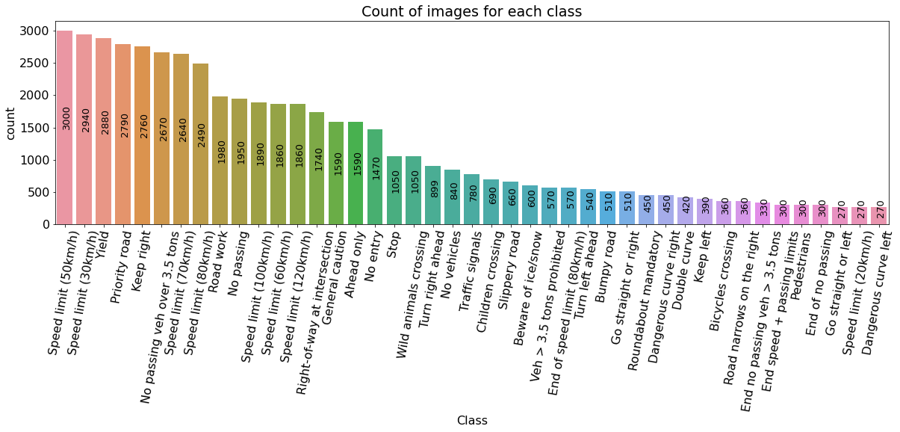
Values Delivery
Exploratory Data Analysis
Classes

Slide 13
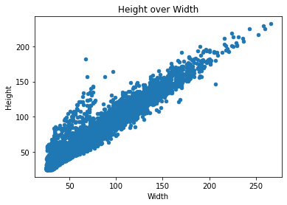
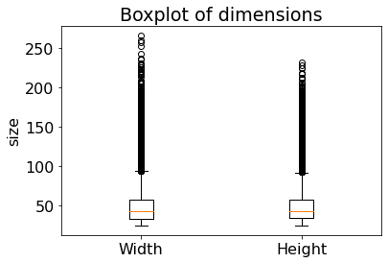
Values Delivery
Exploratory Data Analysis
Dimensions
Highlights
50,000+ labeled images
43 classes
Each class has at least 270 images
On average, the dimension of an image is 50*50 pixels

Slide 14
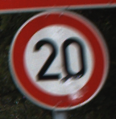
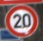
Values Delivery
Pre-process
Load
Resize
To-arrays
Array Red pixels
Array Green pixels
50x50
144x148
Array Blue pixels

Slide 15
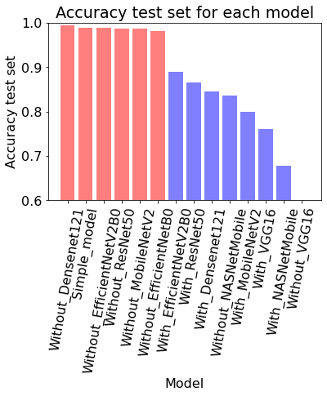
Values Delivery
Modelling + Evaluation
15 deep learning models
Model | With pretrained weights | Without pretrained weights
Simple_model | N/A | 98.9%
ResNet50 | 86.6% | 98.6%
VGG16 | 76.1% | 5.3%
MobileNetV2 | 79.9% | 98.6%
Densenet121 | 84.5% | 99.4%
NASNetMobile | 67.8% | 83.6%
EfficientNetB0 | 98.1% | 98.1%
EfficientNetV2B0 | 89.0% | 98.8%
Chosen model : Simple_model
Reasons :
98.9% accuracy
Fast to compute (10 sec/epoch)

Slide 16
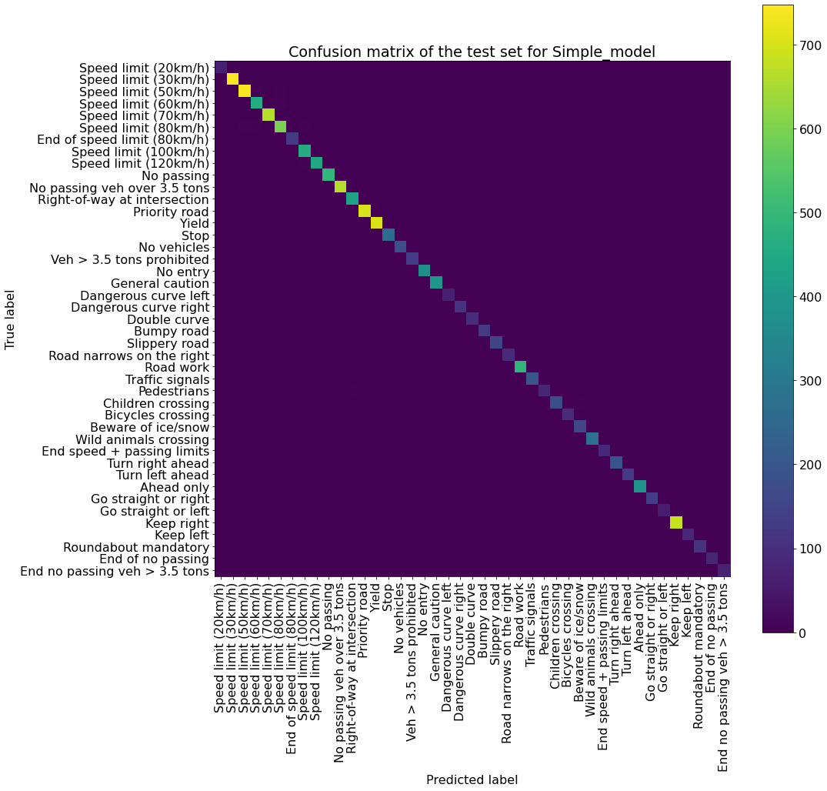
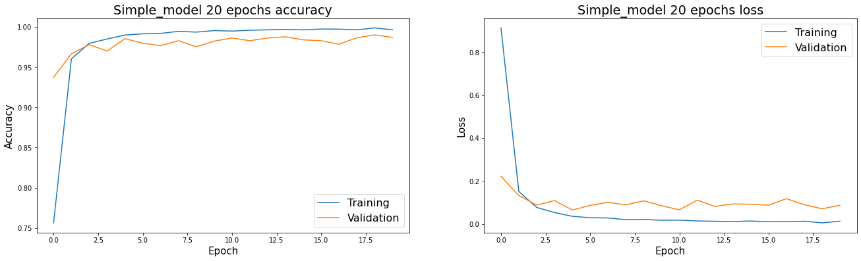
Values Delivery
Best model

Slide 17
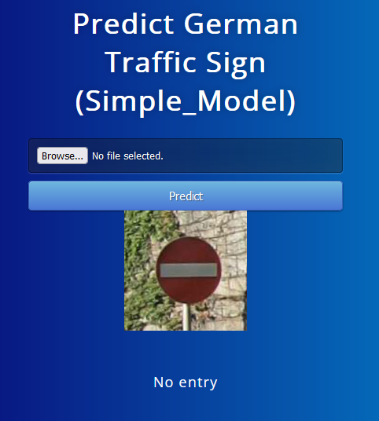
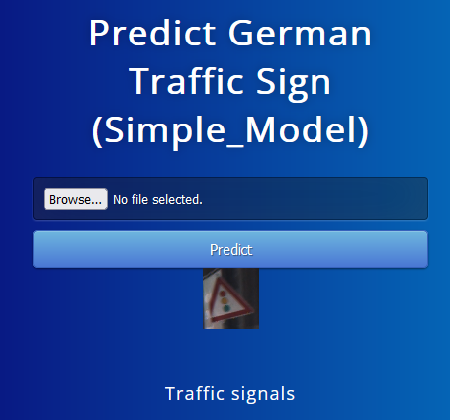
Values Delivery
Deployment

Slide 18
Agenda
Bio
Business problem
Values Delivery
Conclusions
Key figures
Overall process flow used
Summary
Exploration Data Analysis
Stakeholders
Pre-process
Conclusion
Data question
Modelling + Evaluation
Best model
Next steps
Dataset
Deployment

Slide 19
Conclusions
Summary
Business question
Business answer
Modelling
Evaluate the model
Data question
Data answer
Pre-process
EDA
DATA
Simple_model
Fast and accurate (98.9%)
SOLUTION
Check the quality of the data
Check the number of images per class
Know the good dimension to resize
Deployment

Slide 20
Conclusions
Conclusion
Data answer :
Use the Simple_model to predict promptly and with an accuracy of 98.9%
Business answer:
A car can recognize a traffic sign with a great accuracy

Slide 21
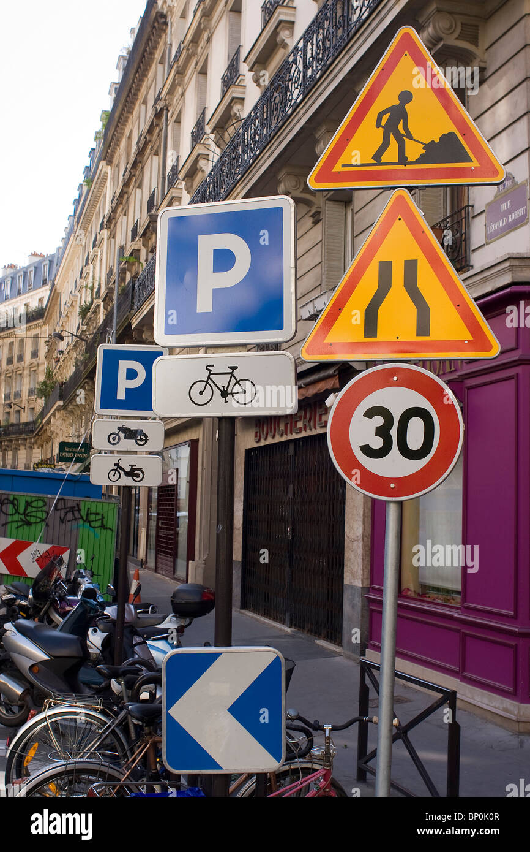
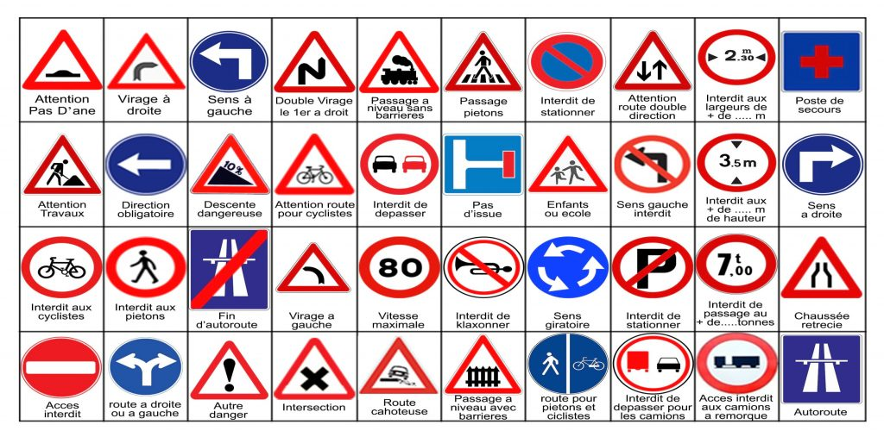
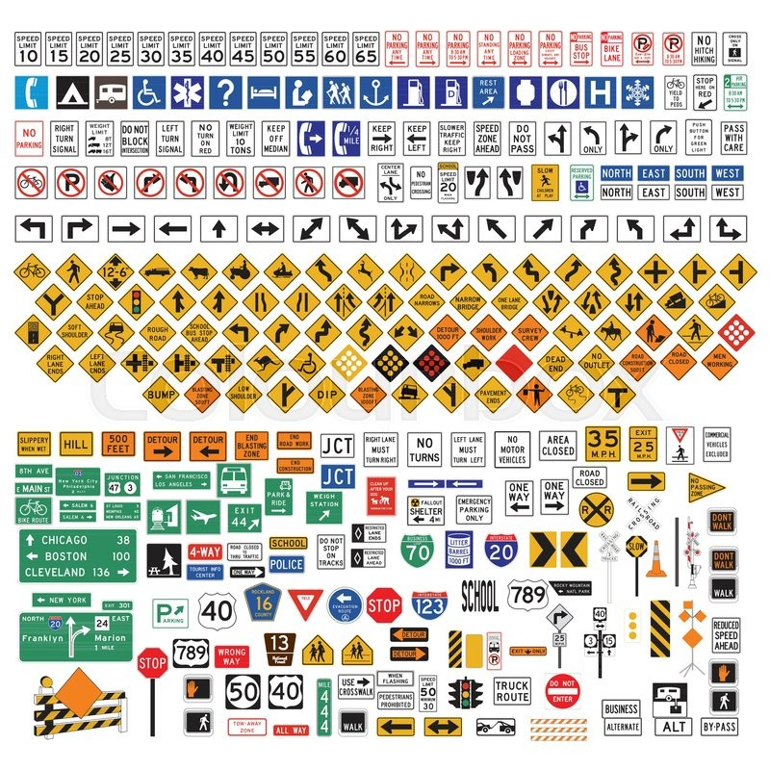
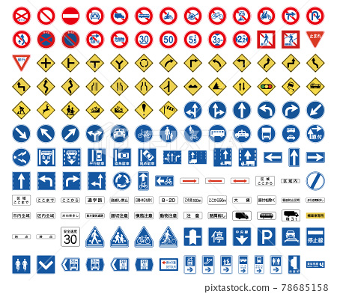
Conclusions
Next Steps
Implement in streaming data (webcam)
Predict ALL the traffic signs from an image
There are not only 43 types of traffic sign in Germany
Germany isn’t the only country

Slide 22

Appendix
https://mccrindle.com.au/article/blog/australians-commuting-on-average-48-minutes-per-day/
https://www.abs.gov.au/statistics/industry/tourism-and-transport/transport-census/2021
https://www.kaggle.com/datasets/meowmeowmeowmeowmeow/gtsrb-german-traffic-sign?select=Test.csv
SUPPORTING DOCUMENTS : IOD Labs 9 and 10
https://keras.io/api/applications/

Slide 23

